Slide 1
ROI: The Acaletics Investment Leon County Schools
April Knight, Director Title I
Dr. Tonetta Scott, Project Manager Research & Evaluation

Slide 2
Why ROI?
What is the impact of our dollars?
Can we support student achievement through a sound methodology to assess programs?

Slide 3
Acaletics
Supplemental Math program
“ conceptual understanding, procedural skills, fact fluency, application”
30 minutes (M-F)
Achievement- % at or above grade level
Annual Learning Gains- as measured by state standardized testing
Subgroup Achievement- race & socio economic status
Comparative Analysis- multi-case study, 5 schools (n=448, students, elementary, 3rd, 4th, 5th)- compare Acaletics proficiency to Florida FSA proficiency (2018-2019)

Slide 4
Leon Acaletics
Title I Schools usage (elementary & middle)
Population-7 participation schools
Over 2,000 students
Grades 1st-8th
Administrator Confidence Level –at or above 90%
Program Cost - $10,000- $40,000 (pp $23-$604)
Implementation Varies

Slide 5
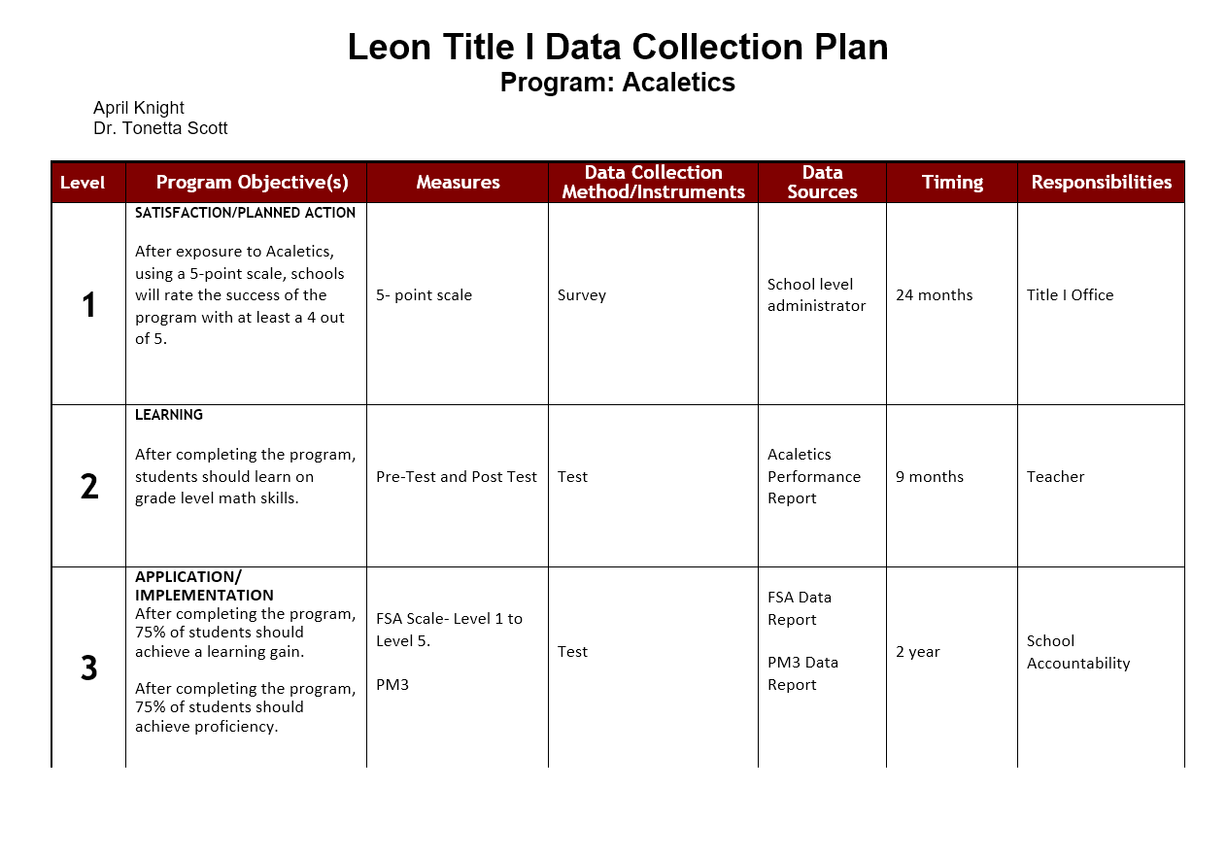

Slide 6
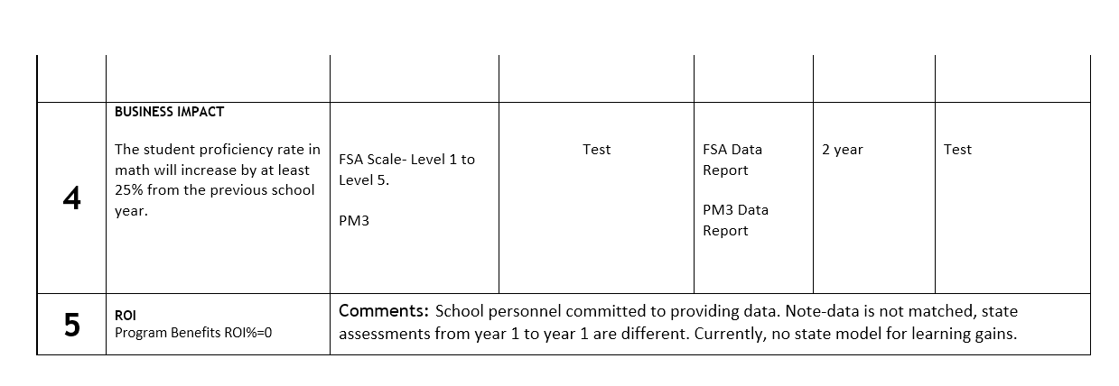
Leon Title I Data Collection Plan Program: Acaletics April Knight Dr. Tonetta Scott

Slide 7
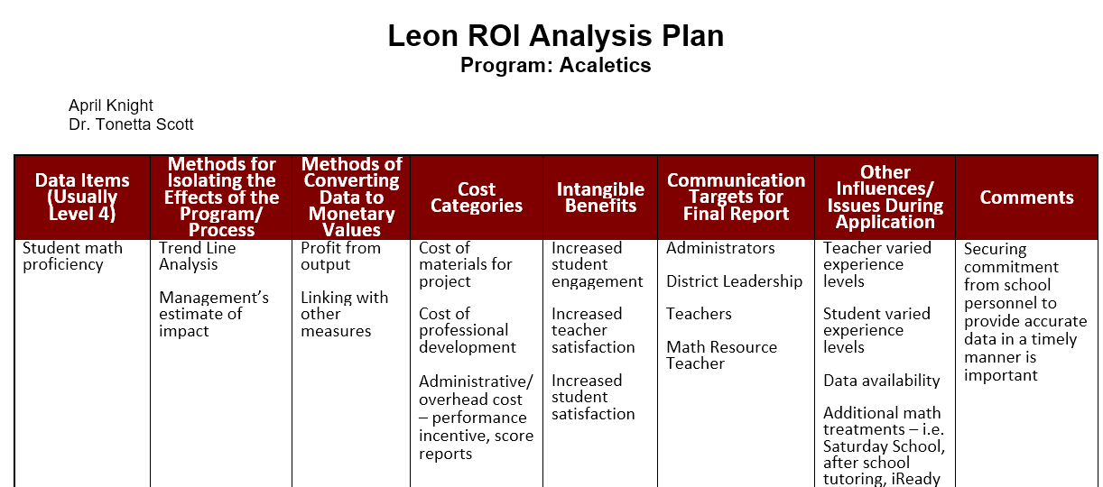

Slide 8
Limitations
*Unmatched Data (noted by vendor and school)
FSA Data to Progress Monitoring (PM1-PM3)
Previous experience with program

